Slide 2
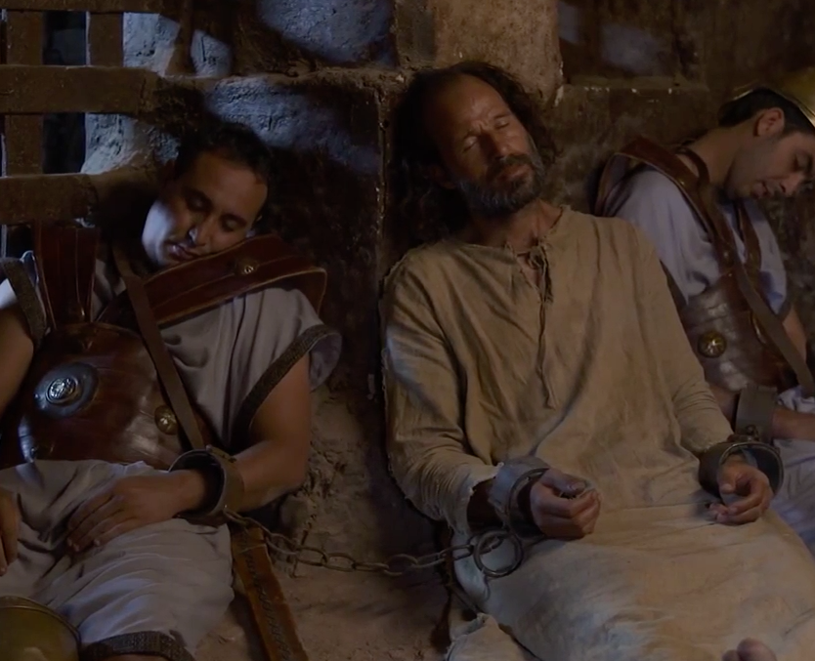
Peter, Teach Me To Sleep…

Slide 3
Events Of Acts Chapter 12
Herod began to persecute the church – 12:1,2
Peter arrested, imprisoned – 12:3-5
Multitudes, even priests, were obedient to the faith- 6:7
Because of Passover, execution delayed – 12:4
Sixteen (16) soldiers guarded Peter in the inner prison- 12:19
Herod familiar with miraculous escape - Acts 5:17-24
The city was excited with anticipation of an early morning execution: “Celebration!”
Herod Agrippa Attempted to kill Jesus as an infant
The son of Herod killed John the Baptist

Slide 4
Acts Chapter 12
Disciples Gathered
They were ASTONISHED!
Didn’t they expect an answer to their prayer?
Did they not believe what Paul later wrote in Ephesians 3:20?
Peter faced trials and dangers before:
He has denied Christ!
Maybe they were asking that he might face death as Stephen and James
PETER SLEEPS! Can you imagine?
Death is CERTAIN! Only hours away!
Many anxieties could have kept him awake
Knew desire of the Jews – they were MAD!
John 16:2; 21:18,19 - PETER SLEPT!
Deep Slumber – 12:7
In Prayer – Prayed without ceasing – 12:5
United in one Purpose – 12:12-16

Slide 5
The Master Taught Peter To Sleep
Mark 4:35-40
Peter KNEW that GOD was awake- Matthew 26:40
God is able to protect – Psalm 121:1-8
God had prover Himself to Peter in the past- No reason to doubt now!
Can we not see that such is true in our lives?
Peace in the presence of God –(Today’s Reading) Psalm 27:1,3
Final words of Jesus before ascending to the Father – Matthew 28:10
Can we not have the same comfort?
“Who is he who will harm you…” 1 Peter 3:13
Wasn’t God awake when James was executed? Mark 10:38,39
How could Peter Sleep?
What did he KNOW that made such possible?

Slide 6
Peter Knew There Was No Reason To Fear Death
Many live in frightful anxiety over DEATH.
Will it hold us in BONDAGE?
Will we permit it to rob us of PEACE, JOY, and HOPE?
This week’s Reading Psalm 4:8
Paul knew in whom he had placed confidence – 2 Timothy 1:12
He was ready to be offered – 2 Timothy 4:6-8
Peter KNEW faithful service would be rewarded- Hebrews 6:10
Romans 8:18 –Reward far exceeding any suffering
Rest for labor – Revelation 14:13
Reap in due season – Galatians 6:9
Psalm 23:1-6
“Fear no evil” Daniel 3:16-18
Philippians 1:21-23

Slide 7
Rest and Reward Were Anticipated
How Well Do You Sleep?
If You Knew This to be Your Last Night?
Would You be Able to Sleep Soundly?
Knowing You Must Stand in JUDGMENT?
John 14:27 – Jesus’ assurance
Revelation 22:14 “Blessed are those who do His Commandments”
IF obedient, no condemnation- Romans 8:1
IF in sin, “May a rock be your pillow and thorns be in your bed” until you turn to Christ in obedience
Make our heart right in the sight of God NOW!
2 Peter 3:12
Ecclesiastes 5:12
Philippians 1:21-23

